Slide 1

Building Intelligent Agents with RAG and pyautogen Claudio Giorgio Giancaterino Bologna, 29 May 2025

Slide 2
Agenda:
NLP evolution: from Bag of Words to Agents
Understanding Retrieval Augmented Generation (RAG)
The new frontier: AI Agents
pyautogen framework
Hands-on Applications

Slide 3

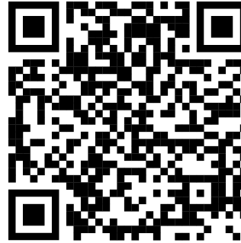
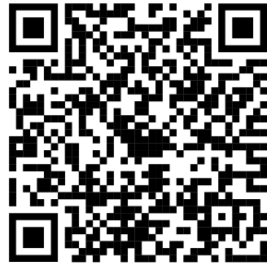
MySelf:
Claudio Giorgio
Giancaterino
Actuary & AI Scientist
Reach Me:
Towards Innovation Lab
Linkedin

Slide 4
NLP evolution: from Bag of Words to Agents

Slide 5
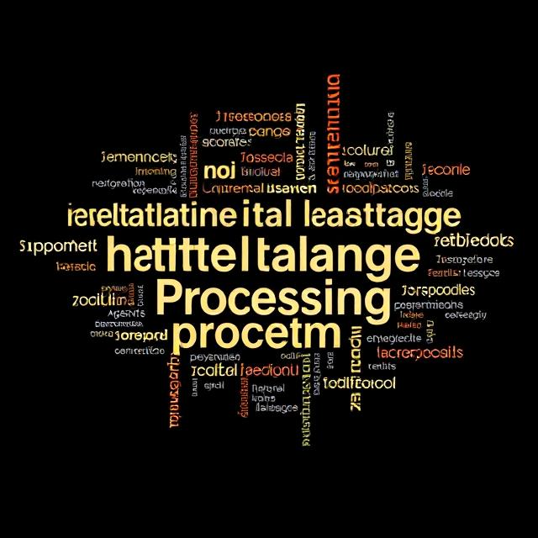
Natural Language Processing
The field of AI focused on enabling machines to understand and interact with human language through computational methods and algorithms.
https://deepai.org/machine-learning-model/text2img

Slide 6
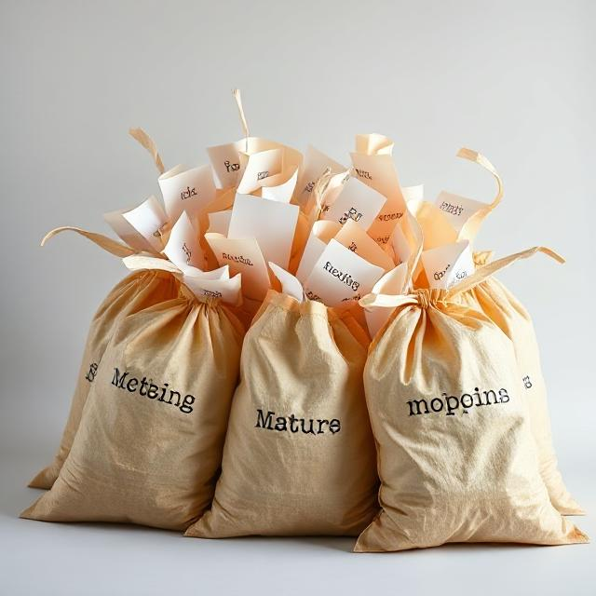
Bag of Words
The first approach for vector representation of text is to count the occurrence of words within a document, ignoring grammar and word order.
https://deepai.org/machine-learning-model/text2img

Slide 7
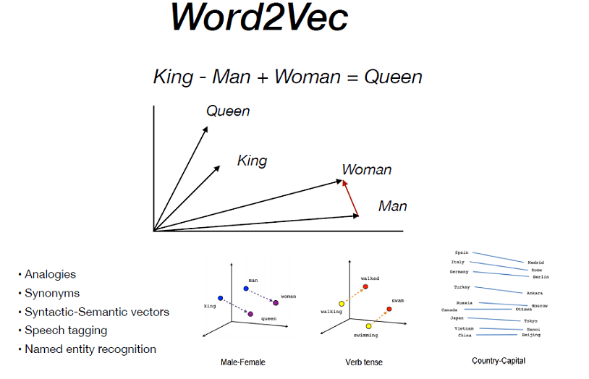
Word Embedding
The evolution of vector representation of text involves extracting the semantic meaning and relationships between words by mapping them into high-dimensional spaces.
https://medium.com/@datasciencemilan

Slide 8

Attention is all you need
The Attention mechanism enables models to weight the importance of different words in a sequence simultaneously generating context for word relationships.
The Illustrated Transformer – Jay Alammar – Visualizing machine learning one concept at a time.

Slide 9
Large Language Models
A breakthrough in the NLP field, with models like BERT and GPT trained on vast amount of text data, showed remarkable abilities in understanding context and generating human-like text.
Step 1: Convert words to number (token ids)
Tokenization
Step 2: Convert token ids into vector
Token Embeddings
Step 3: Calculate the position of each token in the sequence of tokens
Positional Embeddings
Step 4: Assign weights to every word relative to every other word
Self-Attention
Step 5: Predicts the next word by assigning scores for every word
Feed-Forward Network
Step 6: Convert scores to probabilities
Softmax Layer
Step 7: Convert token ids into words
De-Tokenization

Slide 10
Retrieval-Augmented Generation (RAG)
Introduced by Facebook AI Research (FAIR) in 2020, it marries the power of LLMs with external knowledge sources, ensuring fluent and updated answers.

Slide 11
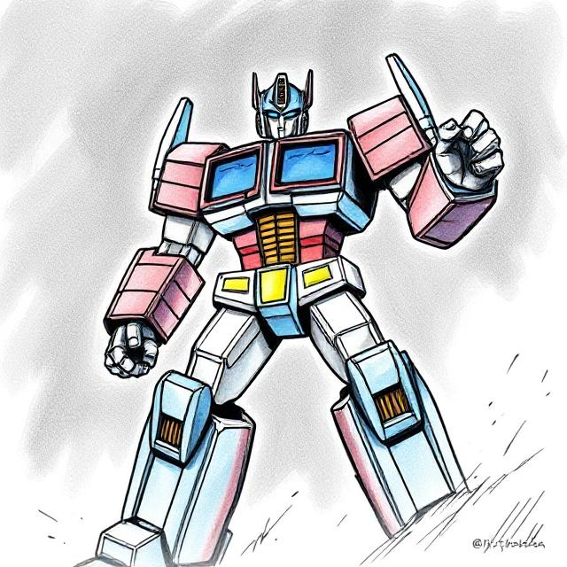
AI Agents
A new era where AI systems not only understand language but can also reason, plan, and interact with their environment to perform complex tasks.
https://deepai.org/machine-learning-model/text2img

Slide 12
Understanding Retrieval Augmented Generation (RAG)

Slide 13
What is RAG?
Retrieval Augmented Generation is an approach designed to enhance the capabilities of Large Language Models (LLMs) by integrating external up-to-date knowledge. It combines a retrieval mechanism with a generative model. The LLM is like a storyteller, while the retriever is like a librarian.

Slide 14
Why RAG?
RAG matters because traditional LLMs generate responses based only on their pre-trained data, which can lead to several issues:
- Data Obsolescence
- Hallucinations
- Inconsistency

Slide 15
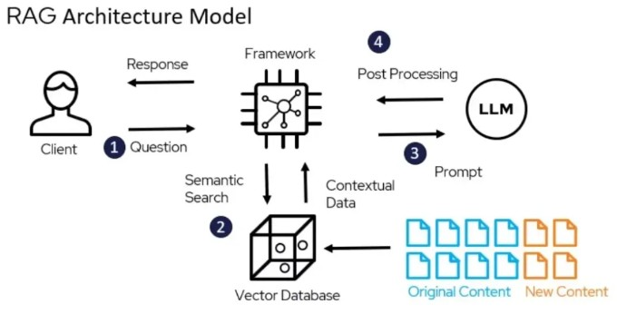
RAG Architecture
* Question: The client submits a question to the RAG framework for processing.
* Semantic Search: The framework searches the vector database to find the most relevant documents or content chunks linked to the user’s question.
* Prompt: The retrieved contextual data is combined with the original question to create an enhanced prompt sent to the LLM.
* Post Processing: The LLM generates a response based on the enriched prompt, which is then processed and returned to the client.
Source: https://shorturl.at/ECI47

Slide 16
RAG use cases
1) Enhanced Content Creation
2) Customer Feedback Analysis
3) Market Intelligence
4) Personalised Recommendations
5) Dialogue Systems and Chatbots

Slide 17
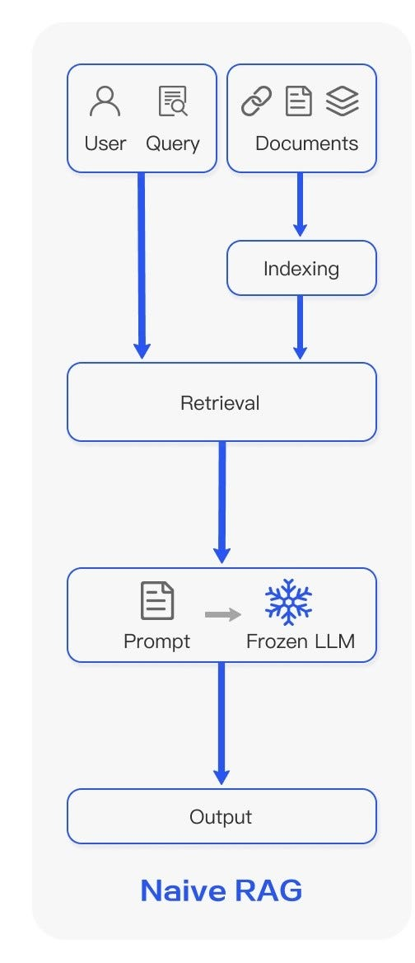
Let’s start with Naive RAG
-Indexing: Data are loaded, split into smaller chunks, then stored and indexed using a vector store and an embedding.
-Retrieval and Generation: Pertinent splits are fetched from storage using a retriever. This retrieval is based on the semantic similarity between the query and the chunks.
An LLM produces an answer using a prompt that includes the question and the retrieved data.
https://shorturl.at/q9wWY

Slide 18
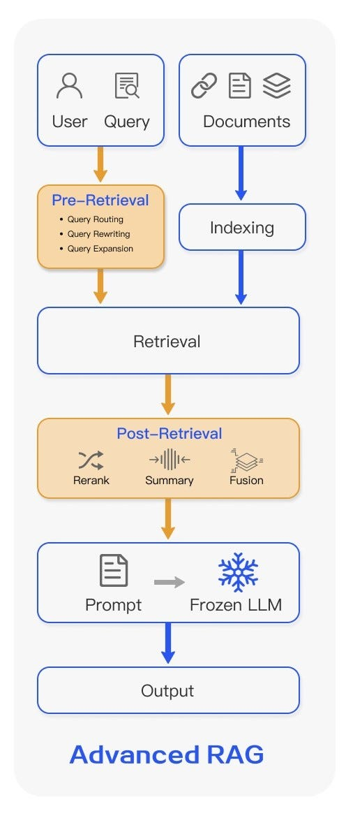
…move to the Advanced RAG
Pre-Retrieval
PDF Parsing: Crucial for extracting information accurately from unstructured documents, including text, tables, and images.
Semantic Chunking: splits text based on content and context to preserve meaning, beyond just rule-based splitting.
Query Rewriting: transforms the original query to align better with document semantics, addressing inaccurate wording.
- Retrieval
Ensemble Retriever/Hybrid Search: Combines multiple retrieval techniques or sources to enhance the relevance and comprehensiveness of search results.
- Post-Retrieval
Re-Ranking: Reorders and filters retrieved documents to place the most relevant ones first.
Corrective RAG: Identifies and rectifies inaccuracies or inconsistencies in the generated responses by cross-referencing retrieved information.
RAG Fusion: Generates multiple derivative queries from the initial query, retrieves all documents, re-ranks them, and ensembles the results for generation.
https://shorturl.at/q9wWY

Slide 19
RAG vs Fine-Tuning
Aspect | RAG | Fine-Tuning
Data Updates | Real-time retrieval | Static training
Cost | Lower | High (retraining)
Domain Focus | Broad (unless specialized) | Deep (domain-specific)
Use Case | Dynamic info, multi-domain | Static, high-accuracy needs

Slide 20
The new frontier: AI Agents

Slide 21
What are AI Agents?
An AI agent is an application designed to achieve a goal by observing the world and acting upon it using the tools at its disposal. These agents are autonomous and can act independently of human intervention when given proper goals. In the context of Generative AI, an agent is a program that enables Large Language Models (LLMs) to perform actions by extending their capabilities through access to tools and knowledge.
LLMs
Action
Knowledge
Tools

Slide 22
Reasoning
Collaborating
Why AI Agents?
-> Autonomously Perform Tasks
-> Adapt and Learn
-> Increase Productivity and Efficiency
-> Enable Personalisation and Scalability
Acting
Observing
Self-Refining
Planning

Slide 23
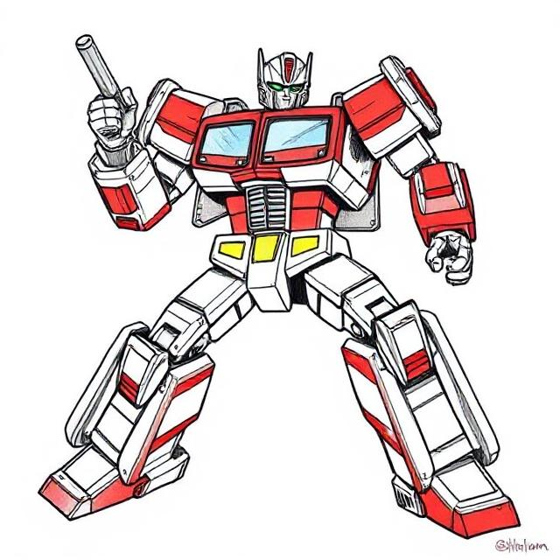
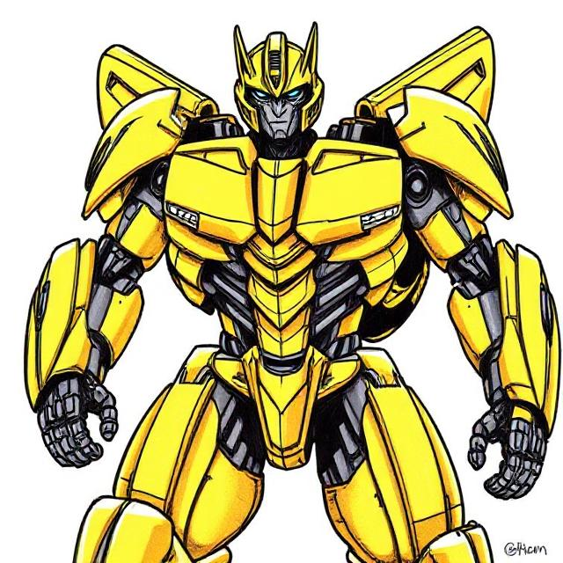
AI Agents Architecture
Single-Agent: One AI agent handles all tasks.
Simple to design and maintain, but less scalable
for complex tasks.
Multi-Agent System (MAS): Multiple agents work together, enabling parallel processing and specialisation. More scalable and robust, but introduces coordination challenges
https://deepai.org/machine-learning-model/text2img

Slide 24
Agentic RAG
Agentic RAG (Retrieval-Augmented Generation) is an advanced AI framework that integrates intelligent agents into the traditional RAG pipeline to enhance adaptability, accuracy, and handling complex workflows. Unlike standard RAG, which follows a linear retrieve-then-generate process, agentic RAG employs multiple specialised agents that actively reason, plan, and orchestrate the retrieval, validation, and synthesis of information from different sources.

Slide 25
Agentic AI vs Agentic RAG
Feature | Agentic AI | Agentic RAG
Core Functionality | Autonomous decision-making, planning, and action | Combines retrieval, generation, and agentic control
Data Retrieval | May or may not include dynamic retrieval | Integrates dynamic, multi-source data retrieval
Adaptability | Continuously learns and adapts | Adapts retrieval and generation based on context
Use Cases | Complex workflows, diagnostics, supply chain | Advanced tasks needing both retrieval and autonomy
Scalability | High, with parallel agents | High, with multi-agent collaboration
Proactivity | Highly proactive | Proactive in retrieval and problem-solving

Slide 26
pyautogen framework

Slide 27
pyautogen framework for agent development
AutoGen (pyautogen), now as AG2, is an open-source programming framework originally developed by Microsoft. It is designed for building AI agents and sophisticated cooperation among multiple agents in order to solve complex tasks.

Slide 28
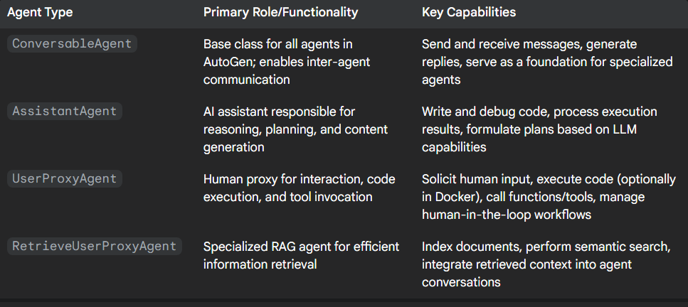
pyautogen agent types

Slide 29
Hands-on Applications

Slide 30
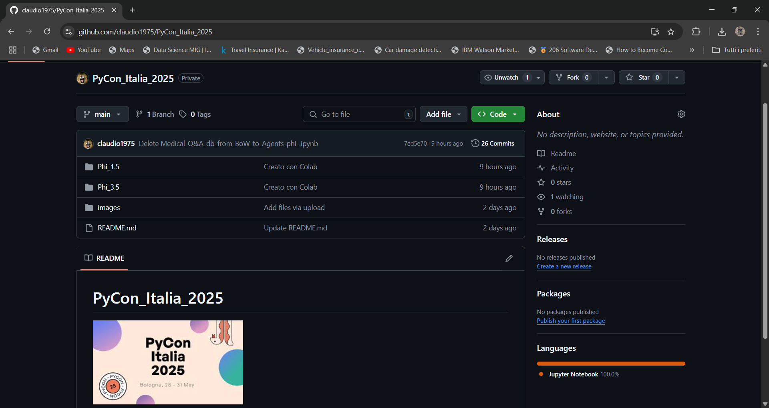
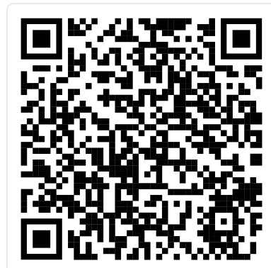
Go to the repository, fork and open notebooks in Colaboratory. Select Phi_1.5 fold unless you have GPU capacity for Phi_3.5. https://github.com/claudio1975/PyCon_Italia_2025/

Slide 31
Medical Q&A from BoW to single agent
It uses a medical dataset with Q&A (https://huggingface.co/datasets/lavita/ChatDoctor-iCliniq) located in the Lavita AI Hugging Face space (https://huggingface.co/lavita). LAVITA is a blockchain-AI-based next-generation healthcare platform that enables the use of massive biomedical datasets for research while preserving individual privacy and ownership of data.
Medical_Q&A_from_BoW to_Agent_Phi_3.5
Medical_Q&A_from_BoW_to_Agent_Phi_1.5

Slide 32
Medical Report Agentic RAG
It uses a source, which is an opinion draft from MedTech Europe (https://www.medtecheurope.org/wp-content/uploads/2024/03/medical-technology-industry-perspective-on-the-final-ai-act-1.pdf), a trade association for the medical technology industry in Europe. It outlines the industry's perspective on the final text of the EU's AI Act, specifically regarding its application to medical technologies.
Medical_Report_Agentic_RAG_Phi_3.5
Medical_Report_Agentic_RAG_Phi_1.5

Slide 33
Medical Report Advanced Agentic RAG
It uses an academic article and analyses how the newly adopted EU AI Act affects medical devices, detailing classification, compliance requirements, provider obligations, and the future impact on digital healthcare products. (https://www.nature.com/articles/s41746-024-01232-3.pdf)
Medical_Report_Advanced_Agentic_RAG_Phi_3.5
Medical_Report_Advanced_Agentic_RAG_Phi_1.5

Slide 34
Set up the notebooks

Slide 35
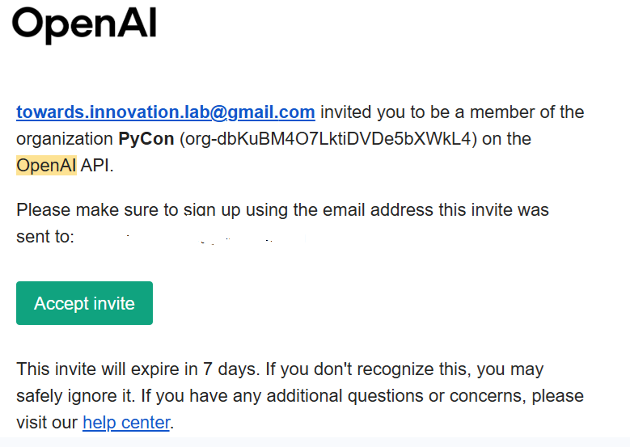
OpenAI API Key
AI agents in the pyautogen framework run using the OpenAI provider. During the workshop, an API key is provided to explore the notebooks. Please send an email with your name and surname to towards.innovation.lab@gmail.com. You’ll receive an invitation, which you should accept. This will enroll you in the project environment and provide you with the API key to upload into the notebooks.

Slide 36
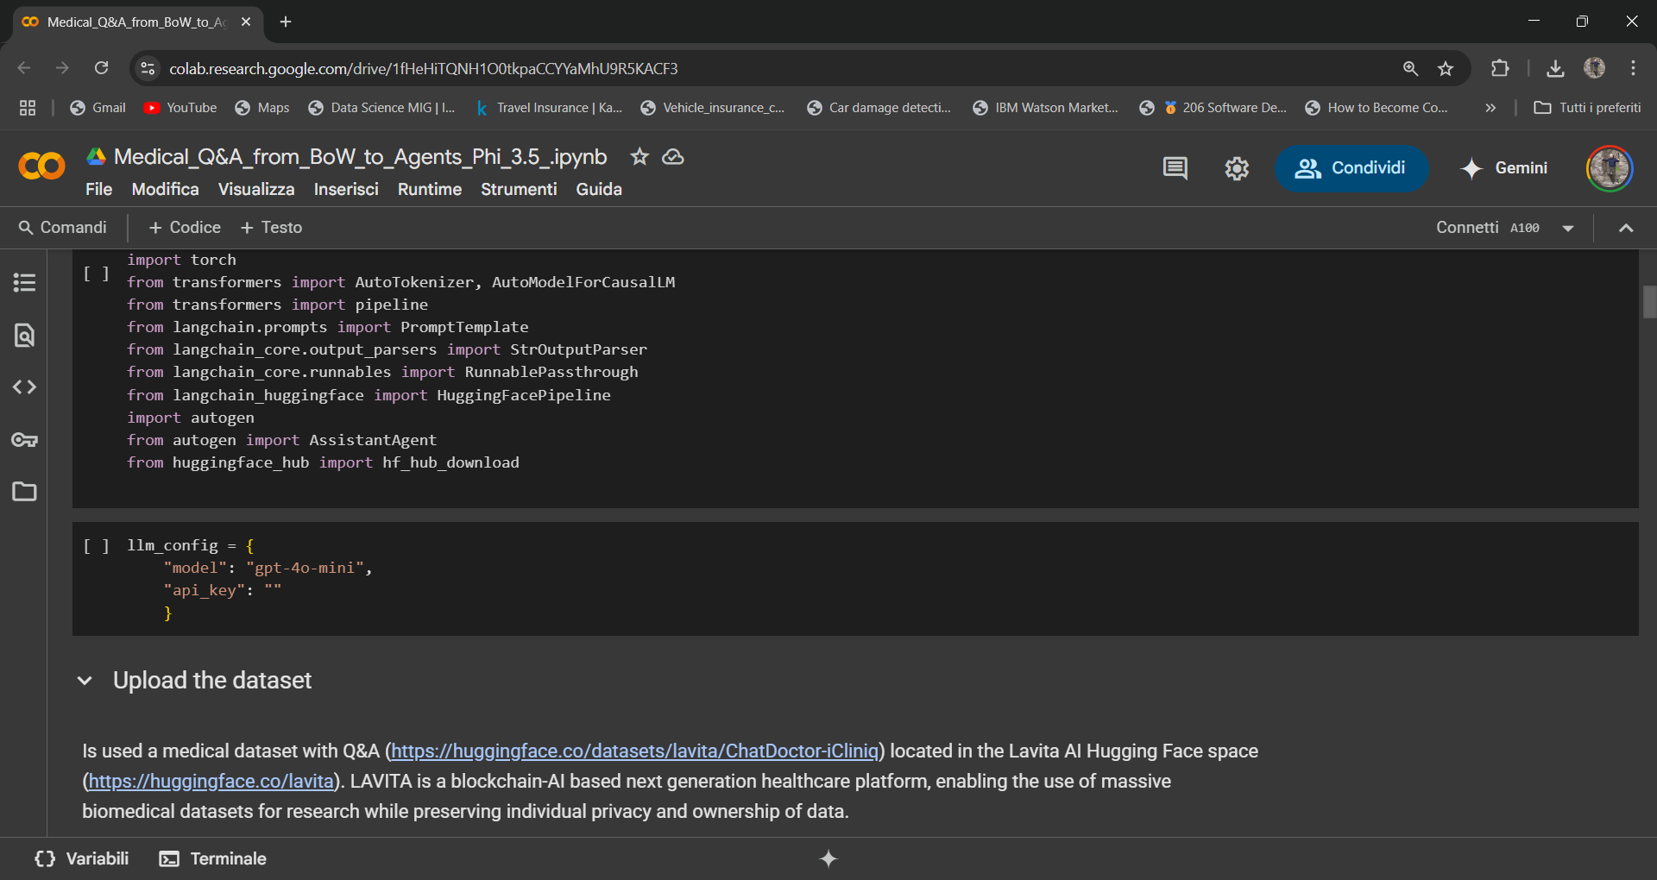
When you receive the OpenAI api key, you can upload it to the notebook for the workshop.

Slide 37
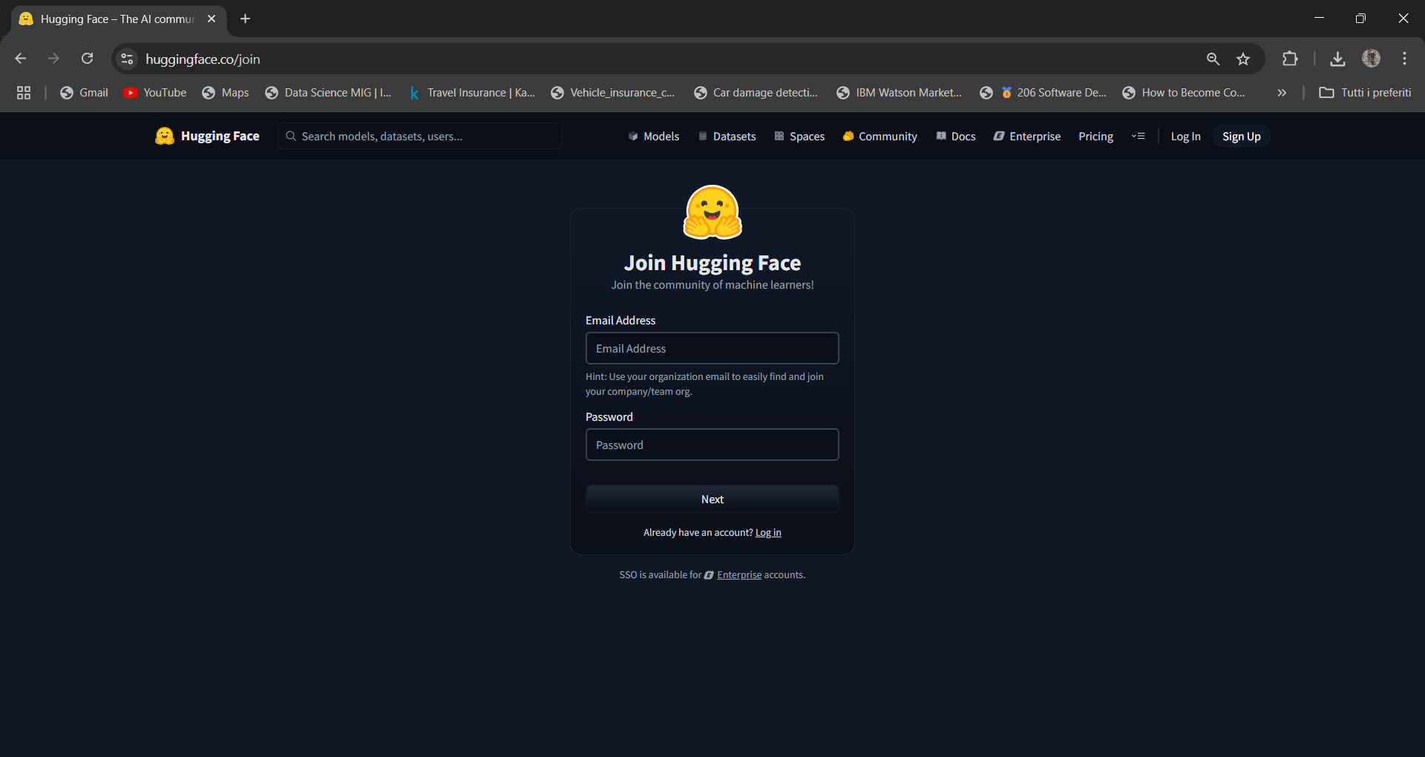
Hugging Face User Access Token
Fetch your token from Hugging Face to download datasets and models from the platform. If you don’t have a Hugging Face account, please sign up; it’s free. https://huggingface.co/join

Slide 38
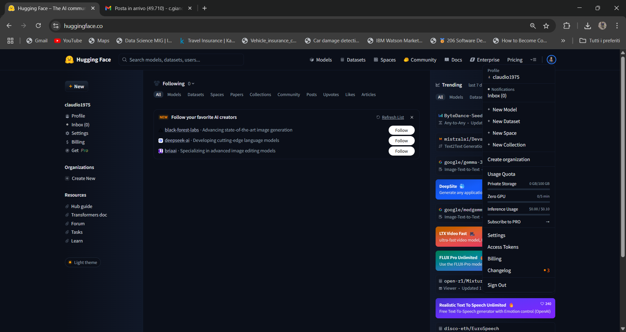
Click on the top right of the web page, on your account menu, and select «access tokens».

Slide 39
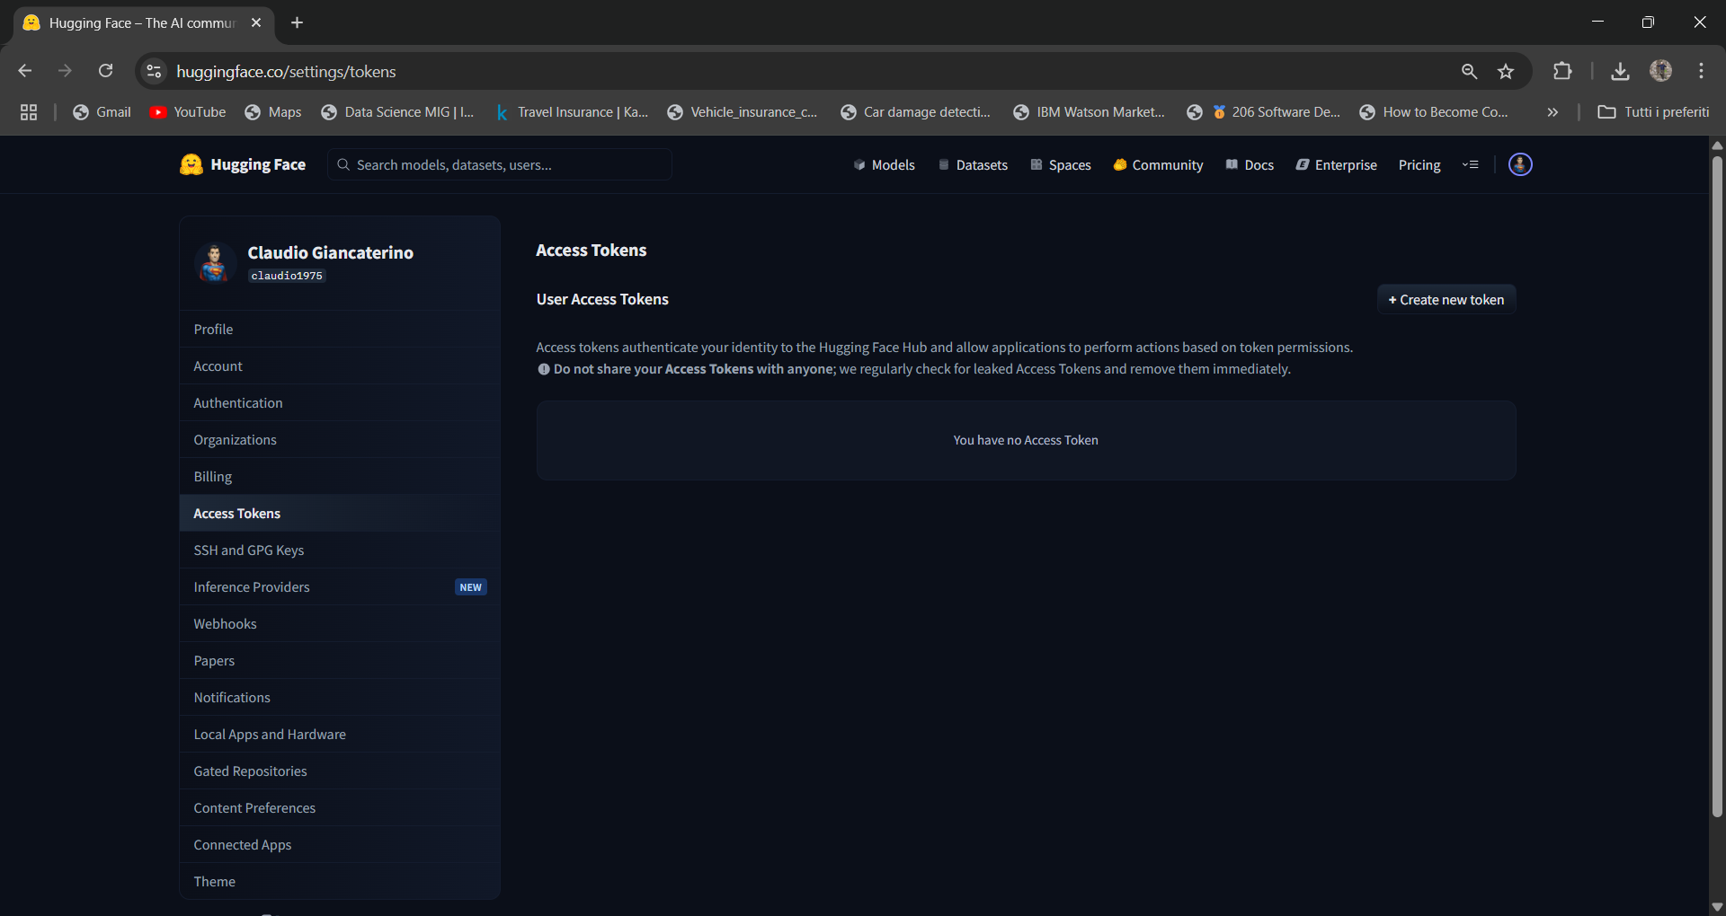
Select create new token

Slide 40
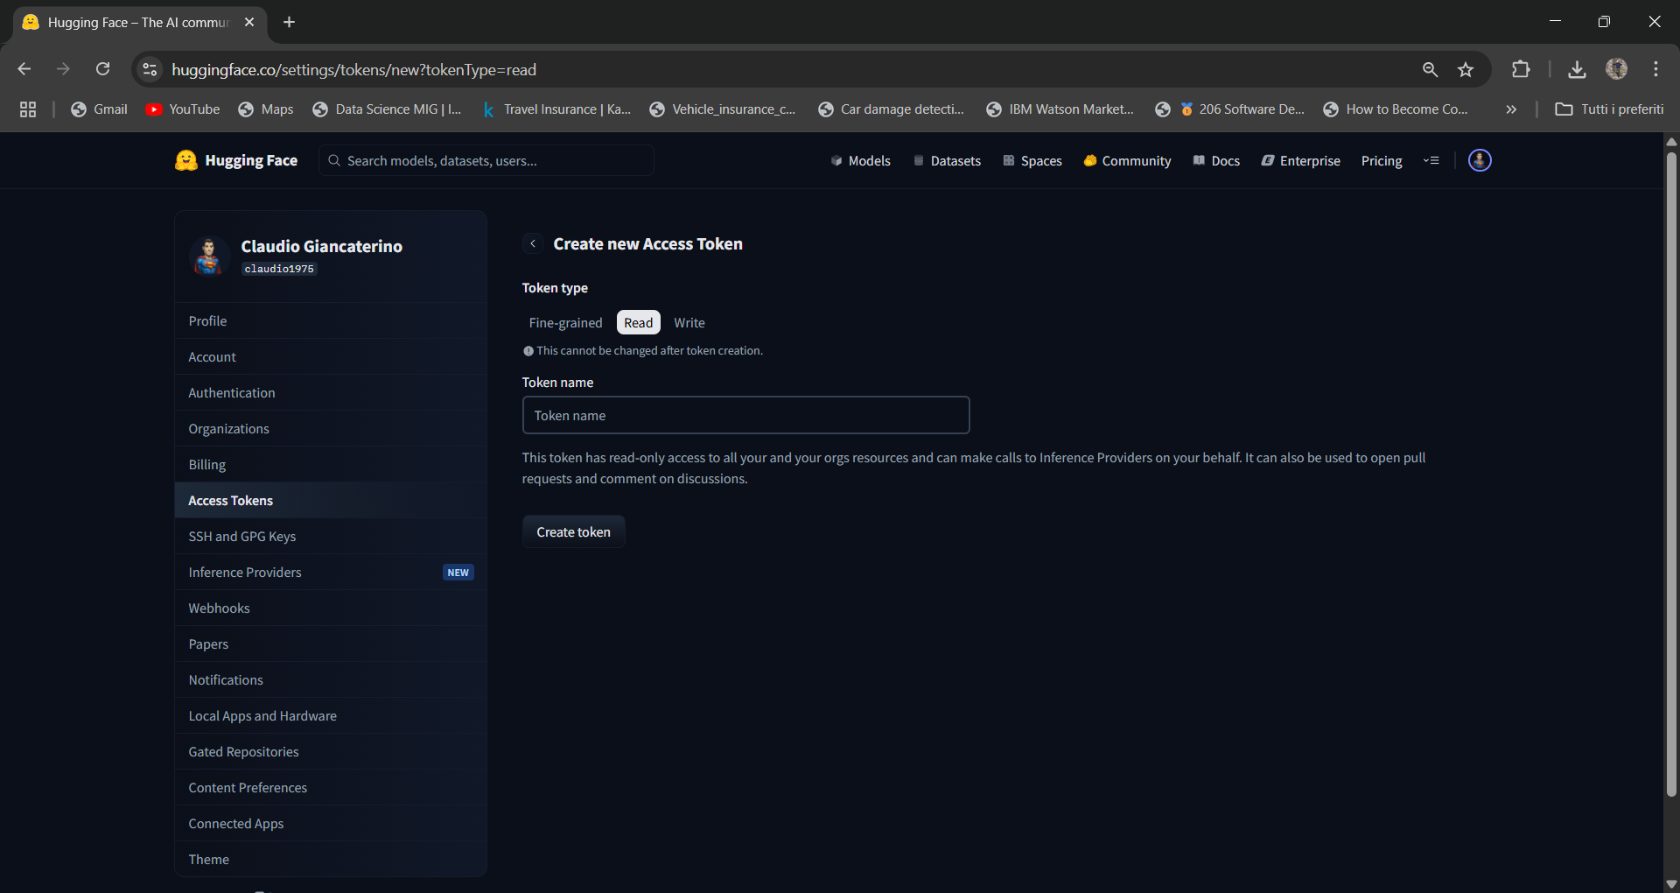
Select read, insert a name and select create token

Slide 41
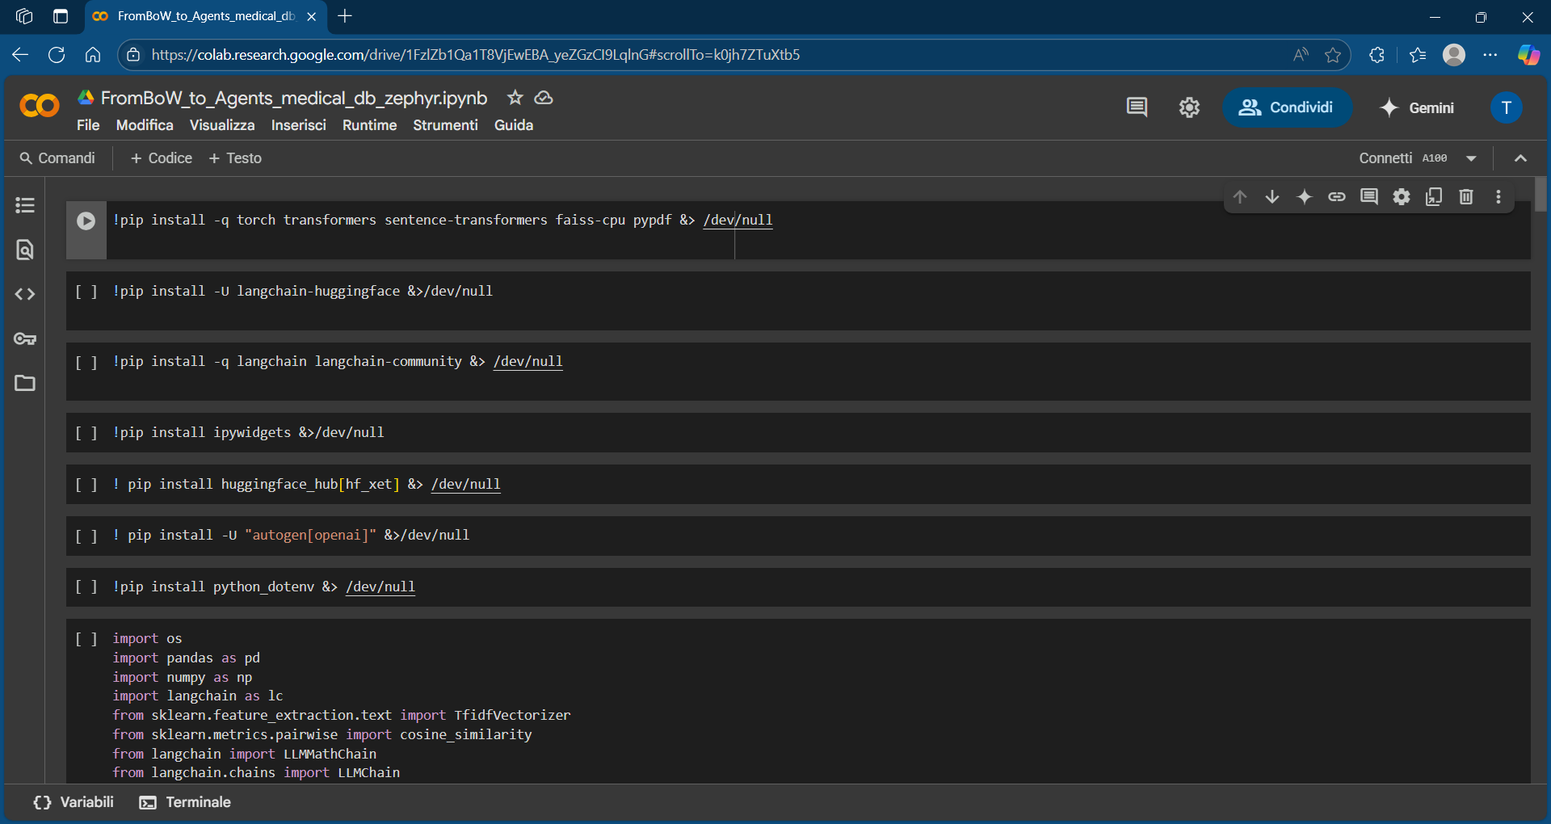
Upload your hugging face token into colaboratory in the secret key

Slide 42
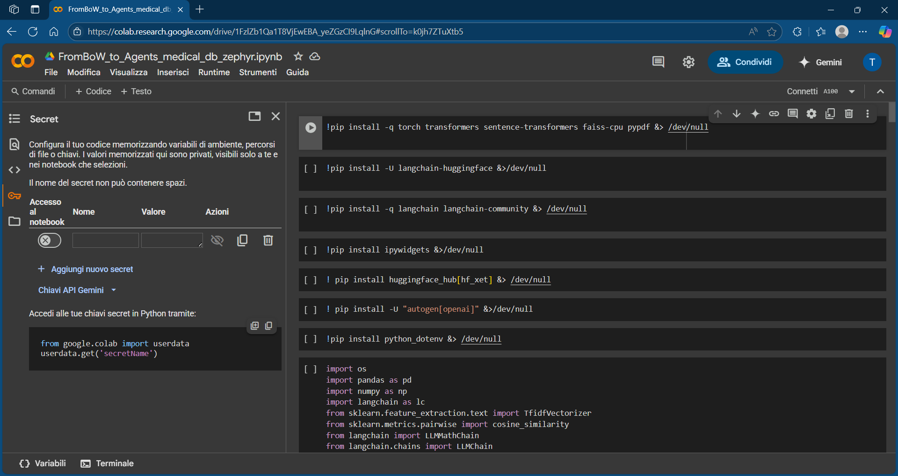
Select the secret key, enable the access to the notebook, input «HF_TOKEN» in the name field and key value of your token

Slide 43
Helpful Resources
User access tokens
How to use Secrets in Google Colab https://colab.research.google.com

Slide 44
References:
Retrieval-Augmented Generation for Knowledge-Intensive NLP Tasks
Attention is All You Need (arXiv)
GPT-1 OpenAI Blog Post
BERT: Pre-training of Deep Bidirectional Transformers for Language Understanding (arXiv)
Efficient Estimation of Word Representations in Vector Space (arXiv)
Bag of Words in Python: A Complete Guide
Embedding_&_Vector_Stores
Foundational Large Language Models & Text Generation
Agents
AI agents — what they are, and how they'll change the way we work – Source
What are AI agents? Definition, examples, and types | Google Cloud
microsoft/ai-agents-for-beginners: 11 Lessons to Get Started Building AI Agents
What is Agentic RAG | Weaviate
RAG, AI Agents, and Agentic RAG: An In-Depth Review and Comparative Analysis | DigitalOcean
[2501.09136] Agentic Retrieval-Augmented Generation: A Survey on Agentic RAG
pyautogen · PyPI
[2312.10997] Retrieval-Augmented Generation for Large Language Models: A Survey

Slide 45
?
?
?
?
Thank you
?
?
?
?
?
My Contacts:
Linkedin
Medium
Website

